Slide 1
Reactive Programming
Non-Blocking: Reactive programming is a declarative programming paradigm that is based on the idea of asynchronous event processing and data streams.
Asynchronous: Asynchronous processing means that the processing of an event does not block the processing of other events.
Back Pressure: The ability of the consumer to request items at different rates or only when it is ready to process them.
Event Driven: Web applications adopt non-blocking servers based on event loop model.

Slide 2
Features of Reactive Programming
Reactive Streams API: Spring Reactive is based on the Reactive Streams API, which defines a standard for asynchronous stream processing in Java. This API provides a common set of interfaces and methods for working with reactive streams.
Non-Blocking IO: Spring Reactive uses non-blocking IO to handle requests, which means that requests are processed asynchronously, without blocking the thread. This allows the application to handle a large number of concurrent requests with fewer resources.
Flux and Mono: Spring Reactive introduces two new data types called Flux and Mono. Flux is a reactive stream that can emit zero or more items, and Mono is a reactive stream that can emit zero or one item. These data types are used to represent asynchronous sequences of data.
Reactive WebClient: Spring Reactive provides a reactive WebClient that can be used to make HTTP requests. The WebClient uses non-blocking IO to make requests and returns a Flux of response objects.
Reactive Controllers: Spring Reactive provides support for reactive controllers that can handle reactive requests. Reactive controllers use the Reactive Streams API to process requests asynchronously.

Slide 3
Business Use Case
The major challenge for any e-commerce application is to scale and support concurrent requests coming from the users, hence creating the orders.
To cater to this challenge, we have implemented microservices using Spring web flux which supports reactive programming for checkout functionality.
Reactive microservices are highly scalable and resilient.
Business Features
Add products to the basket
Retrieve the products from the basket
Update the details of the basket
Create the order

Slide 4
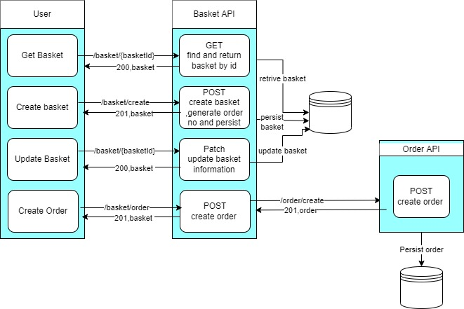
Solution Approach
To cater to the business use case, we have implemented the below-mentioned microservices:
Below is the solution flow diagram:

